Slide 1
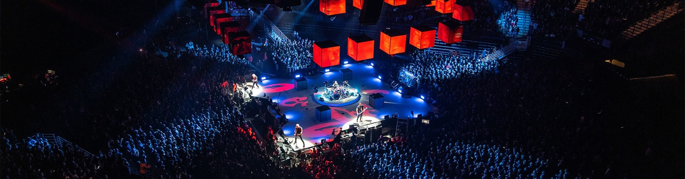
Metallica Gig Analysis
Part 1.1 : Data Acquisition (Primary)
by Sam Ho
sam@samho.co.uk

Slide 2
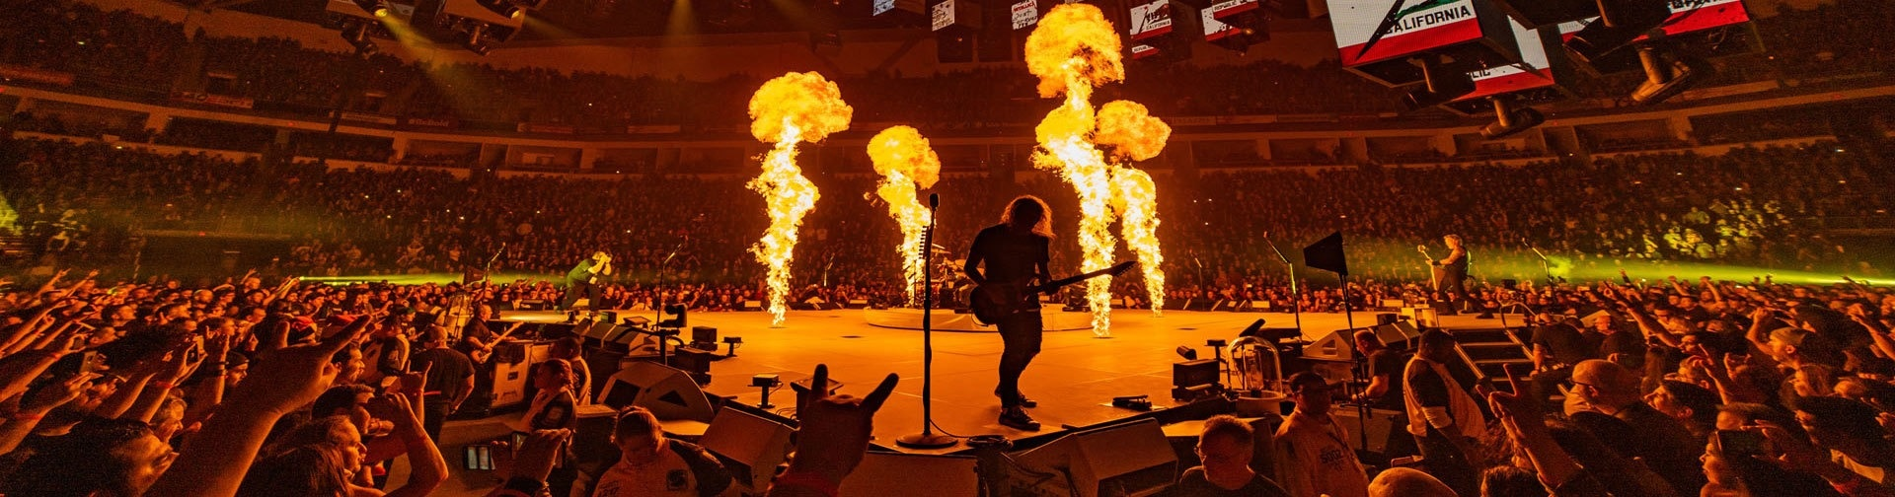
Metallica Gig Analysis
Part 1.2 : Data Acquisition (Secondary)
by Sam Ho
sam@samho.co.uk

Slide 3
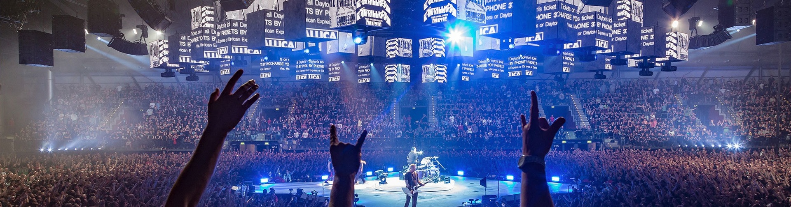
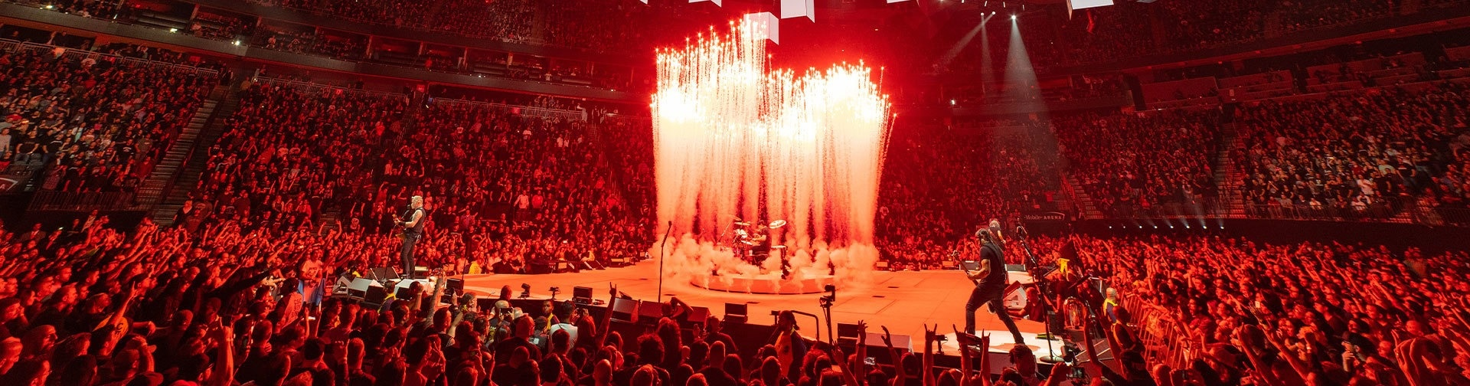
Metallica Gig Analysis
Part 2 : Data Cleaning & Feature Engineering
by Sam Ho
sam@samho.co.uk

Slide 4

Metallica Gig Analysis
by Sam Ho
sam@samho.co.uk

Slide 5
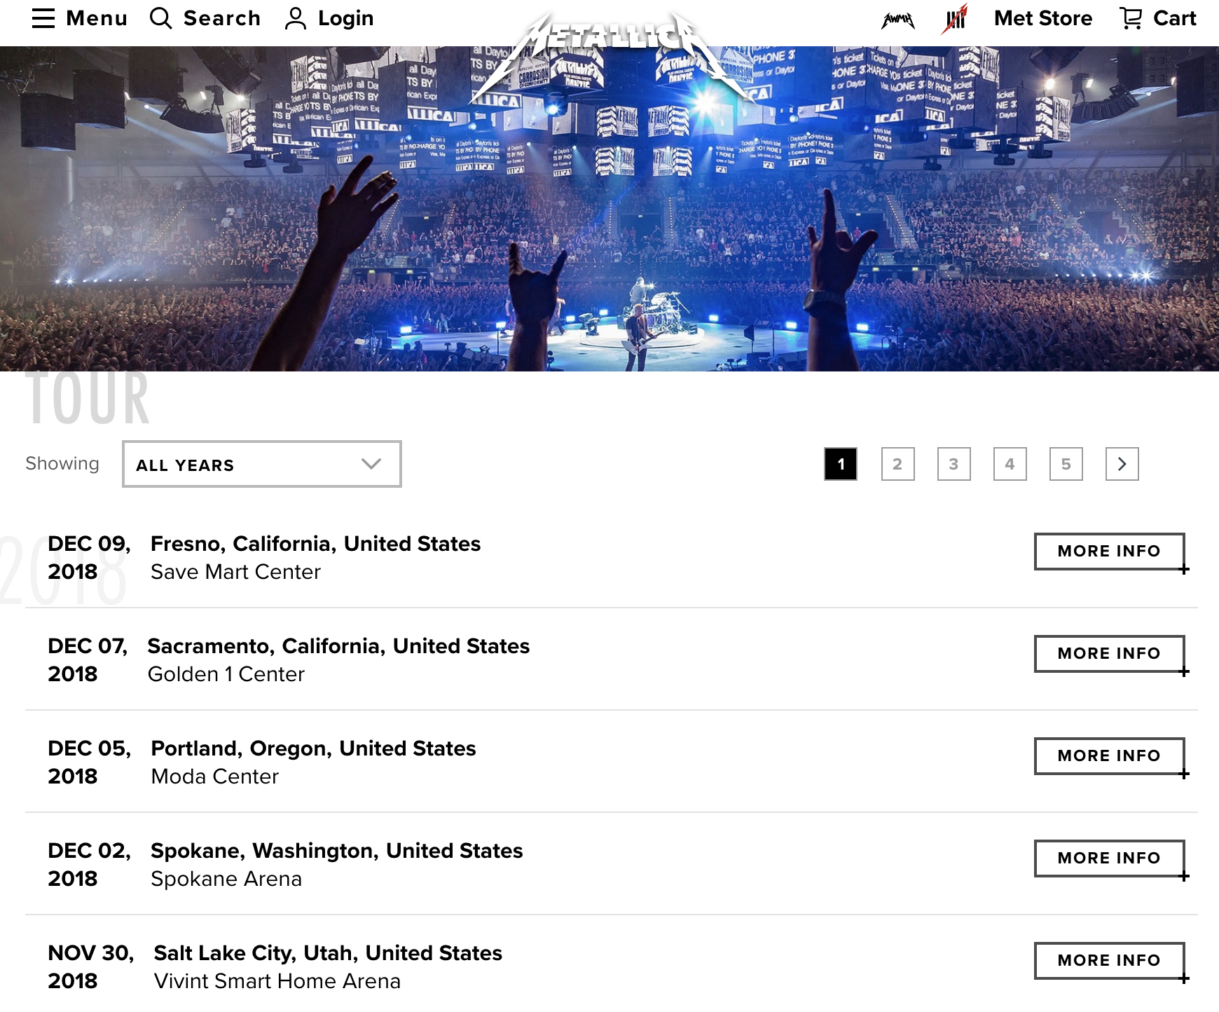
Page URL’s (x99)
Each containing c.20 gig URLS
Gig URL’s
(x2070)

Slide 6
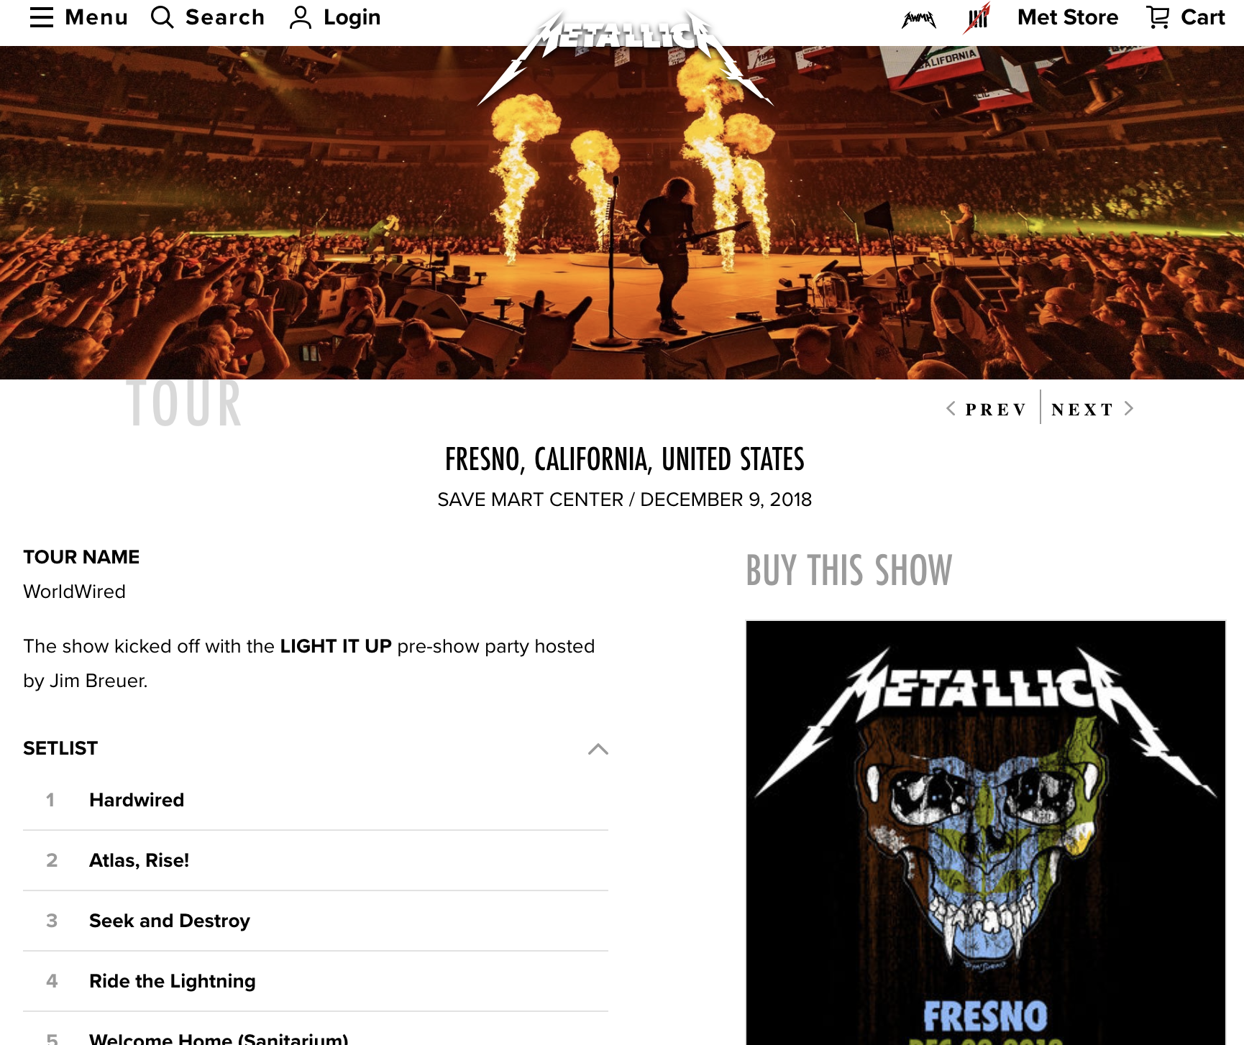
Gig Page (x2070)
Take:
Venue
Date
Country
Tour name
Setlist
Other Acts (not shown)

